Slide 1
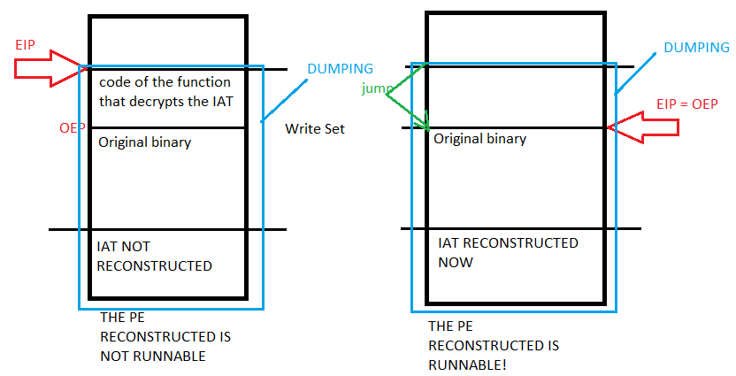
THE RECONSTRUCTED PE IS NOT RUNNABLE
THE RECONSTRUCTED PE IS RUNNABLE
(a)
(b)

